Slide 1
Enterprise Blockchains
Hyperledger

Slide 2
Enterprise Blockchain
Hyperledger Fabric

Slide 3
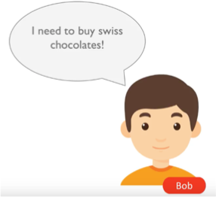

Why Enterprise Blockchain?
Suppose Bob had a special deal with Alice to buy swiss chocolates
However …
Example Source: edureka blog “What is Hyperledger – An Industrial Approach to Blockchain”

Slide 4
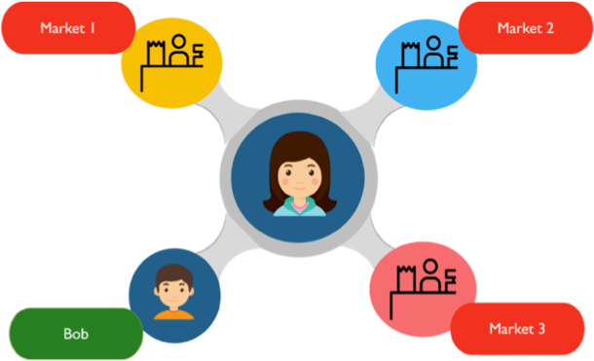
Why Enterprise Blockchain?
Alice wants to sell her products to a number of different markets at standard/different rates

Slide 5
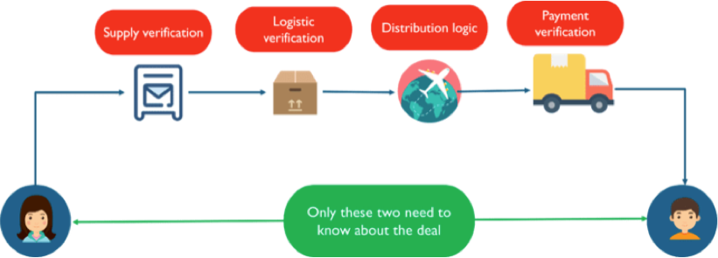
Why Enterprise Blockchain?
a lot of third parties are required to complete the transaction, but they do not need to know about the special deal between Bob and Alice

Slide 6
Why Enterprise Blockchain?
Recall that on a public blockchain everyone knows the deal
In our example, other markets and all third parties know the deal between Bob and Alice
Confidentiality and Privacy is the key requirement for enterprise blockchain

Slide 7
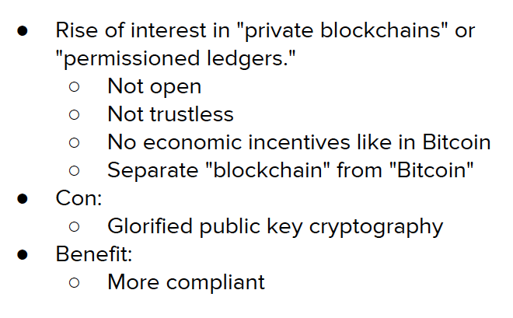
Why Enterprise Blockchain?
（合规）

Slide 8
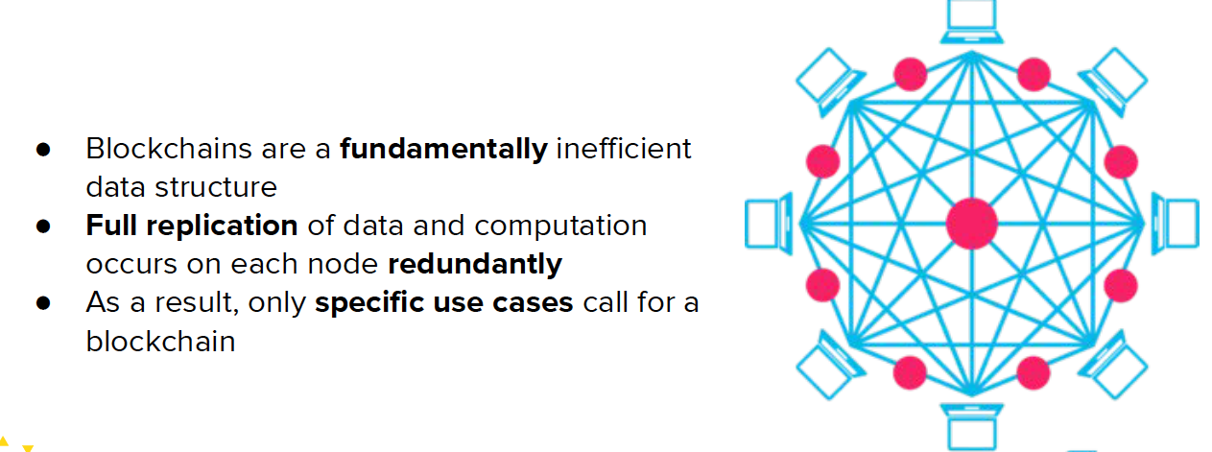
Cons of Blockchain for business
- Scaling Issues

Slide 9


Motivation of Permissioned Blockchains
Enterprises need
Transparency between partners
Scaling efficiency (both low latency and high throughput)
Confidentiality rules
Permissions and auditability for each user
Enterprises don’t need too much
Decentralization
Transparency to everyone

Slide 10
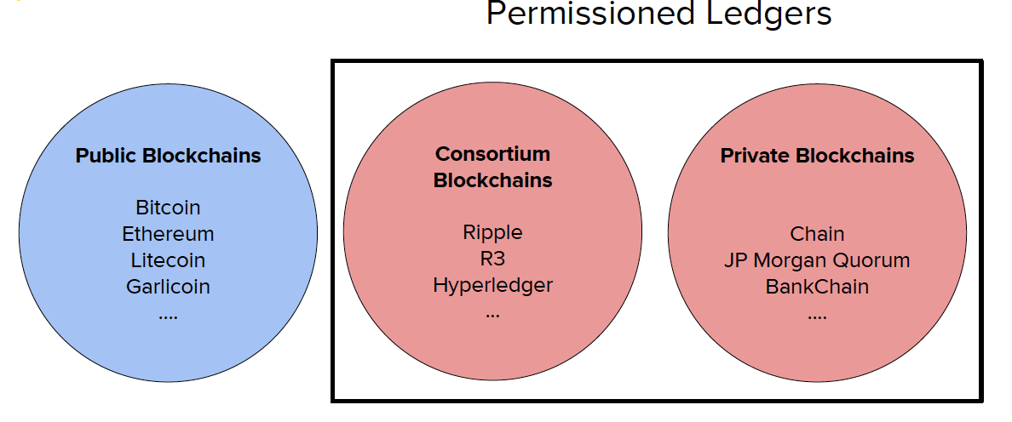
PUBLIC VS. PERMISSIONED Blockchains

Slide 11
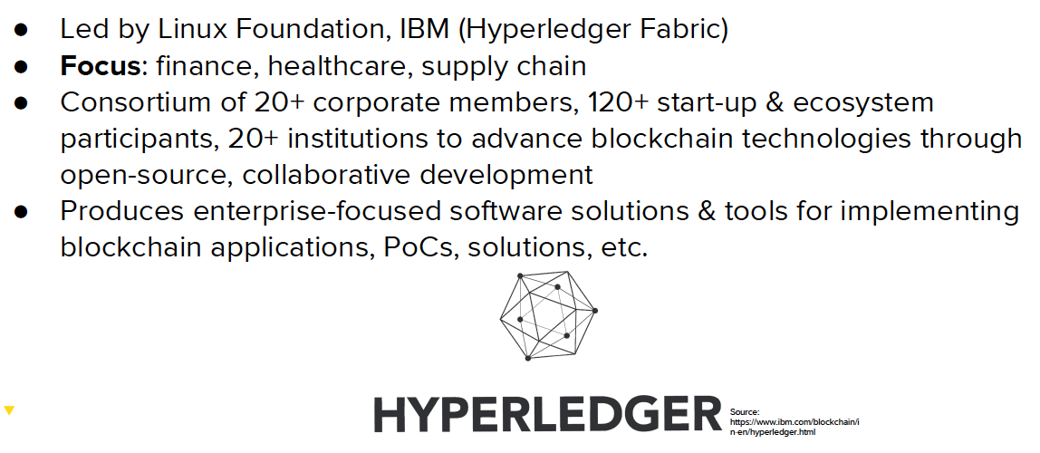
Enterprise Blockchain: Hyperledger

Slide 12
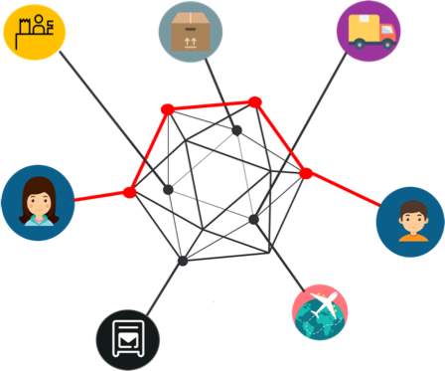
Hyperledger Solution
The peers directly affiliated with the deal are connected, and only their ledgers get updated about the deal
Third parties only know the exact amount of information they need with the help of permission and regulations on the network

Slide 13
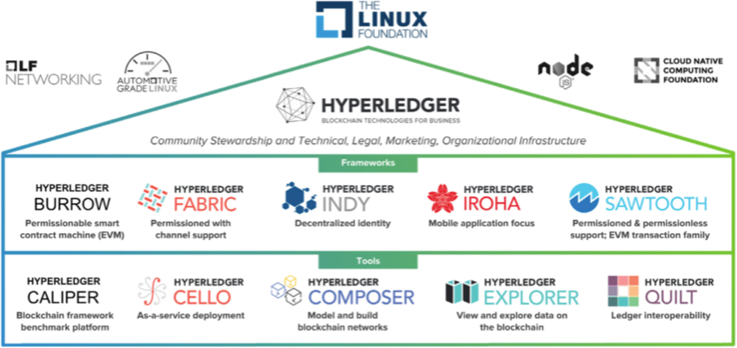
Hyperledger Frameworks
Image source: smart contract white paper @ hyperledger.org

Slide 14
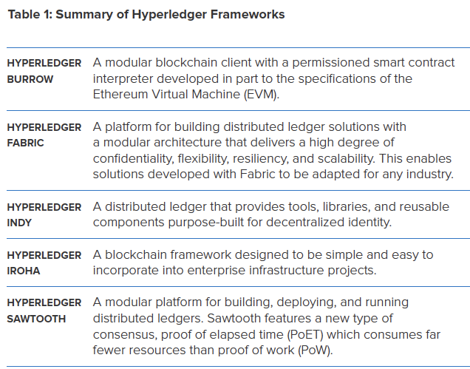

Slide 15
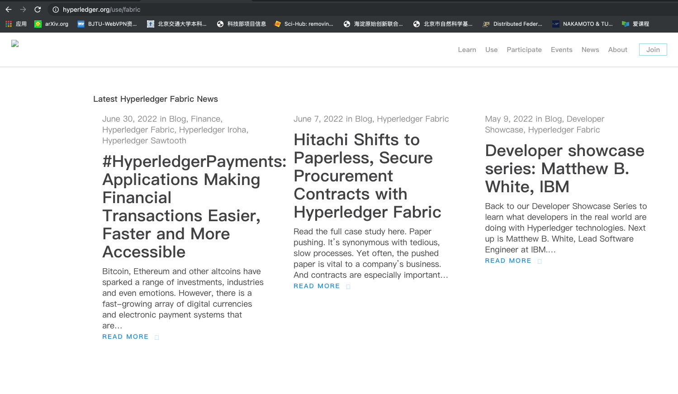
Hyperledger.org

Slide 16
Data Sharing Between Multiple Tiered Partners
“I want to easily share a ledger with Company A and its supplier Company B without their competitor Company C having access. But we’re on the same network!”
Here, each company is represented by an Organization in a Hyperledger Fabric network
My peer would create the genesis block for the ledger shared with a peer in Company A and a peer in Company B, giving access and permissions
To assure confidentiality, I do not include any peer belonging to Company C in the permissions for this ledger

Slide 17

Possible Use Cases
Supply chain transparency, archiving and tracking
“Where does the fish ordered in this restaurant was caught?”
Hyperledger Sawtooth is a Blockchain platform supporting both permissioned and permissionless ledgers

Slide 18
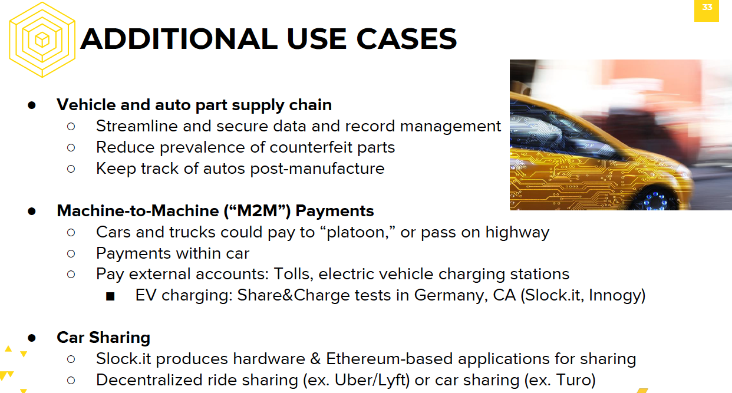

Slide 19
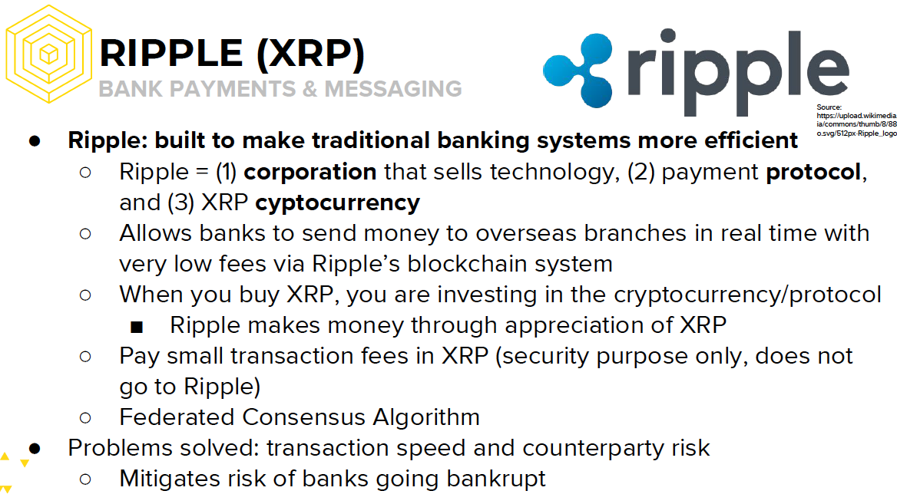

Slide 20
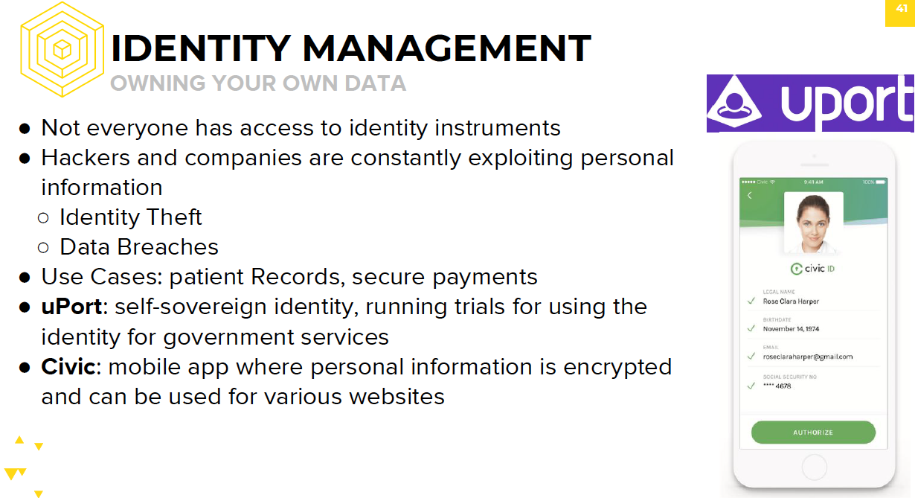

Slide 21
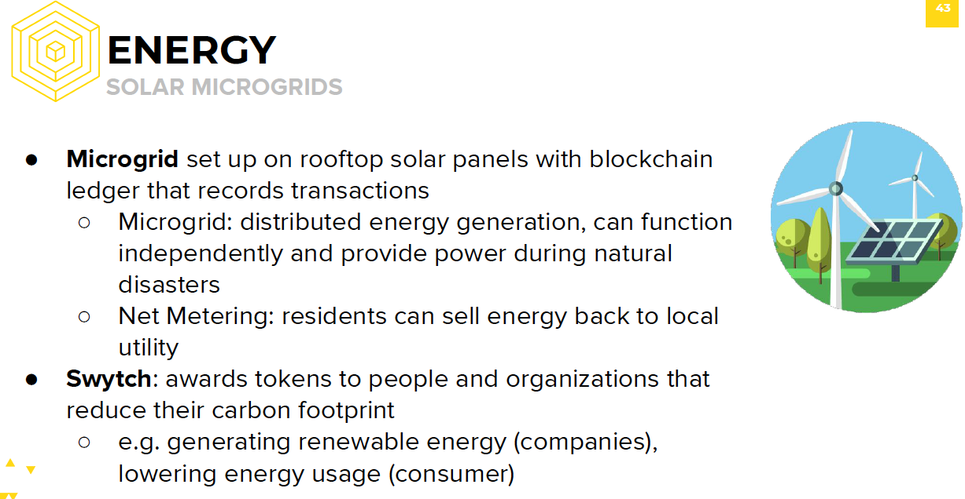

Slide 22
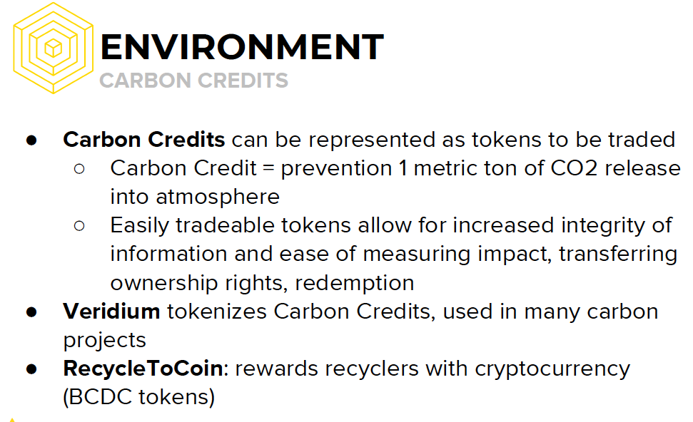

Slide 23
Technology in Hyperledger Fabric

Slide 24
Network Architecture
Org 1
Org 2
Organizations: Companies that want to exchange data and trust
Peers: Different services（Departments） within a company
Users: Individuals(Apps) who connect to their peer to log into the network
Peer 1
Peer 2
Peer 3
Ledger 1 + Chaincode
0
1
2
Ledger 2 + Chaincode
0
1
2
3

Slide 25
Network Architecture: Sending a Transaction
Org 1
Org 2
A user uses her app to
Connect to her peer,
Send transactions to a specific ledger
Orderer: Special node who validates blocks
There can be multiple orderers, from different organizations
Consensus is achieved by Proof of Authority or by the Kafka consensus mechanism
1
Orderer
2
2
Peer 1
Peer 2
Peer 3
Ledger 1 + Chaincode
Ledger 2 + Chaincode

Slide 26
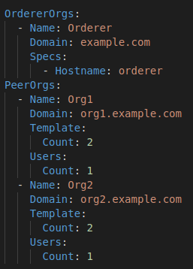
Setting up a Network with a Configuration
File
The step up is done in a structure
defined in a .yaml config file

Slide 27
Setting up a Network
The config file is used to generate
Orderer Certificate
Peer Certificate
User Certificate
App Certificate
These certificates can be used to access the network

Slide 28
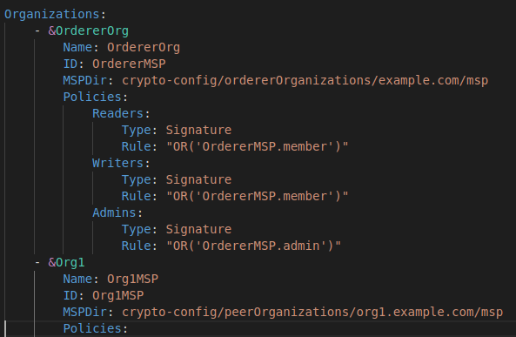
Setting up a New Ledger
A ledger can be shared between peers by generating its genesis block from another .yaml config file
You define in it which peers have access to the ledger and which orderer will be used to validate blocks

Slide 29
A New Ledger of Transactions
With the genesis block file and your certificates, you are all set to start sending transactions

Slide 30
Chaincodes
Hyperledger smart contracts, called “chaincodes”, can be written in multiple languages
Example: Node, Go, Java
Non-deterministic code cannot be used!
HTTP Requests
Random number generators
Any code which would behave differently on multiple nodes
Solidity is inherently deterministic, which is not the case of these languages

Slide 31
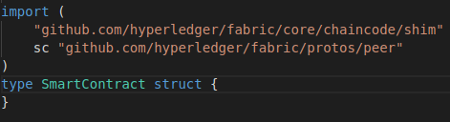
Writing Hyperledger Smart Contracts
Using Go, you can write a smart contract by importing Hyperledger libraries and creating a custom type object for your contract

Slide 32
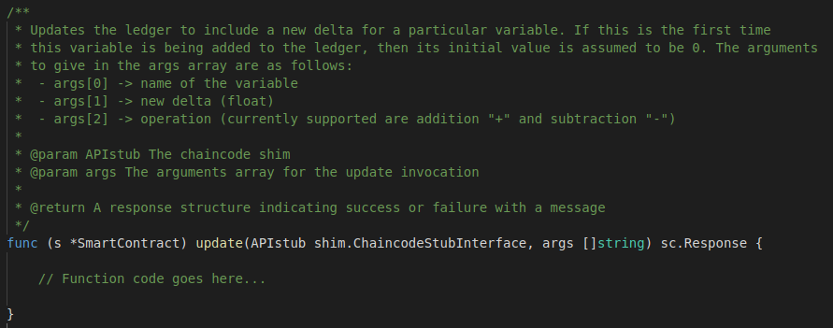
Writing Hyperledger Smart Contracts
Then, you append your functions to this object using prototypes

Slide 33
Hyperledger Resources
Project’s website: https://www.hyperledger.org/projects/fabric
Github: https://github.com/hyperledger/fabric#releases
Technical documentation: https://hyperledger-fabric.readthedocs.io

Slide 34
References
Blockchain in Enterprise: How Companies are using Blockchain Today
https://blockchainatberkeley.blog/a-snapshot-of-blockchain-in-enterprise-d140a51
1e5fd
Enterprise Blockchain is Ready to Go Live
https://www.coindesk.com/enterprise-blockchain-ready-go-live-2018/
Enterprise Blockchain Ready for Breakout
https://www.coindesk.com/enterprise-blockchain-may-finally-ready-breakout/

Slide 35
Group Assignment
Group discussion to decide your final report topics: e.g.
Layer 2 Scaling Solutions
Modular Blockchain - sharding
Cross-Chain Tech: Cross-Chain Bridges, Cross-Chain Messaging Protocols
Zero-Knowledge (ZK) Proofs and Privacy
Real-World Asset (RWA) Tokenization
Decentralized Physical Infrastructure Networks (DePIN)
New Smart Contract Platforms: e.g., Solana
AI x Blockchain: e.g., Decentralized AI Training
Find at least 5 reference papers on this topic ：
Submit your selected report topic, your group name, table of content, and the 5 reference papers.
Reference style (IEEE Citation):
[1] X. Zeng, N. Hao, J. Zheng and X. Xu, "A consortium blockchain paradigm on hyperledger-based peer-to-peer lending system," in China Communications, vol. 16, no. 8, pp. 38-50, Aug. 2019

Slide 36
Exercise：Open a Linux virtual machine on Ali Cloud，install Hyperledger Fabric in Docker
1）Install Fabric
Recommended setup: ECS account , X86, 2 Core CPU, 1G memory， t6, public mirror，Linux version ubuntu 20 ，with all shared resources you can limit the price to 0.05RMB/h, Bandwidth: 1M。
Set password for your instance, select private network connection (VPN).
By using cloud server nodes abroad, you can avoid the GWF to interrupt downloading opensource code. E.g., servers in Singapore.
https://ecs-buy.aliyun.com/wizard?spm=5176.ecscore_server_list.0.0.4c8b4df5L771Xu#/spotPostpay/cn-zhangjiakou
https://ecs-buy.aliyun.com/wizard?spm=5176.ecscore_server_list.0.0.11bd4df52J6hFy#/prepay/ap-southeast-1
2）Run shell scripts for Fabric, line 1-61
Which include install Docker。
After exercise, turn off VM, which stop running the instance but keep your code on it.

Slide 37
The End

